Slide 1
Text Summarization
Sonali Agarwal(02)
Pranita Redkar(63)
Aditi Gaur(45)

Slide 2
What is Text Summarization? And why do we need it?
We can define a summary as a text which reflects the main and important sentences from the original text.
The intention of text summarization is to express the content of a document in a condensed form that meets the needs of the user. Here, the summary is generated by computer.
This can prove useful for a user to fetch the data of his/her interest without wasting much time in reading the whole document.
Since getting manual summaries would be tedious at times, this would certainly reduce efforts and time and give better result.

Slide 3
What are the types of Text Summarization?
The extractive: In this method, text summarization based on some features like title similarity, term frequency, sentence ranking etc are extracted to form summary.
The abstractive: In this method, paraphrasing the sentences of the original document is done to generate the summary.

Slide 4
What are the techniques for implementation?
Text Summarization Based on Fuzzy Logics: A design of a Fuzzy logic system usually involves selecting membership function and fuzzy rules. The four main components of the Fuzzy Logic were: fuzzifier, inference engine, defuzzifier, and the fuzzy knowledge base.
Text Summarization Based on Deep Neural Networks: Restricted Boltzmann Machine (RBM) is a stochastic neural network used in this technique.

Slide 5
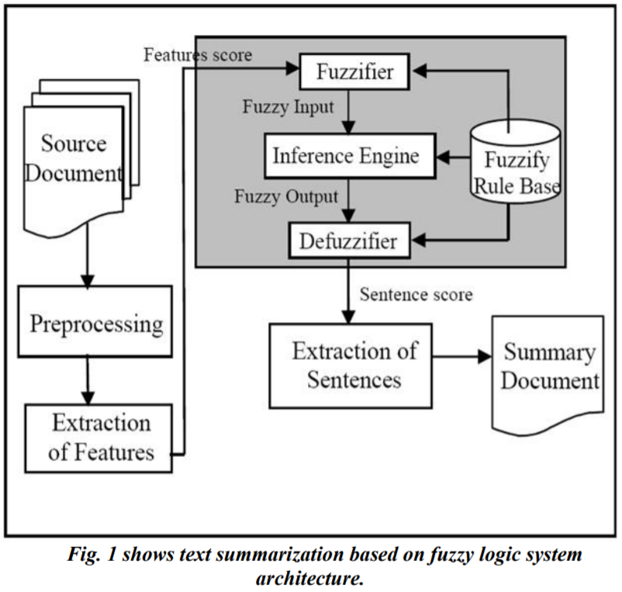
How does Fuzzy Logic work?
In the fuzzifier section, snappy inputs are translated into linguistic values.
After fuzzification, to derive the linguistic values, the inference engine refers to the rule base containing fuzzy IF THEN rules.
Finally, the defuzzifier converts the output linguistic variables from the inference to the final crisp values which represents the final sentence score.

Slide 6
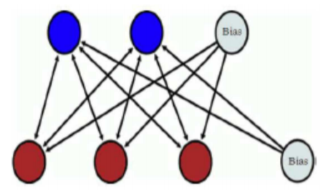
How does Deep Neural Network Work?
We use Restricted Boltzamnn Machine (RBM) in this method.
It consists of one layer of visible units (neurons) and one layer of hidden units.
Units in each layer have no connections between them and are connected to all other units in other layer as shown in the figure.

Slide 7
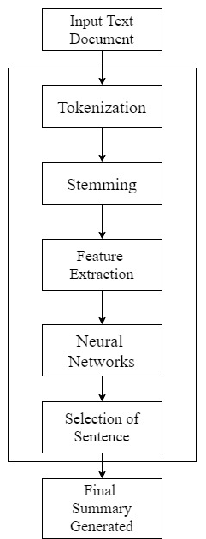
(Continue)
The sentence matrix containing a set of feature vectors is given as an input to the RBM phase as a visible layer.
During the first cycle of RBM, a new refined matrix is generated
During step 2 the same procedure will be applied to this obtained refined set to get the more refined sentence matrix set with hidden layers.
After obtaining the refined sentence matrix from the RBM it is further tested on a particular randomly generated threshold value for each feature we have calculated.

Slide 8
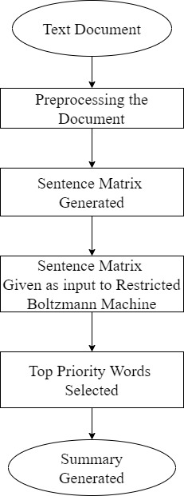
Our Algorithm
Step1 : Input the text document
Step2:-Preprocessing the document
Tokenization
Propernoun in the sentence.
Stop word removal.
Stemming.
Step3:-Feature Vector Extraction
Tilte similarity.
Positional feature.
term weight
concept feature
Step4:-Deep learning algorithm.
Step5:-Summary generated.

Slide 9
Evaluation Metrics
Recall gives the amount of summary that is retrieved correctly.
Precision gives the fraction of summary that is correct.
F-measure gives the accuracy of the system

Slide 10
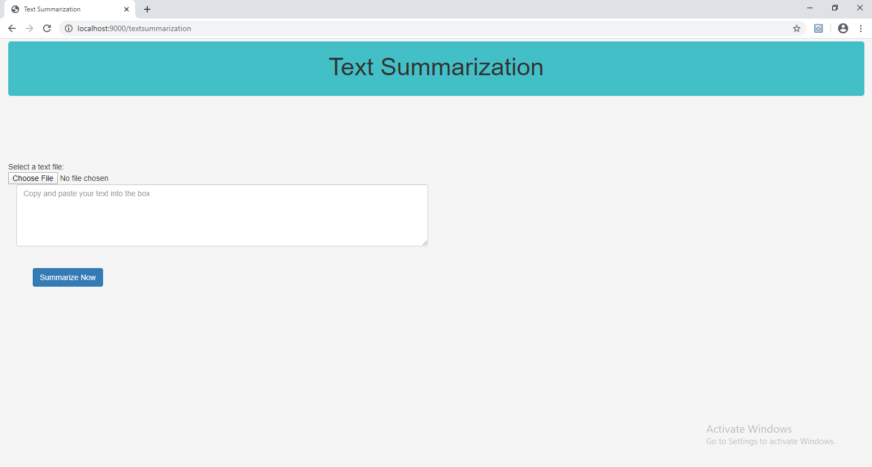
Results
The objective of the system is to provide a summary of any given text document.
The method that we proposed incorporates RBM algorithm for getting better efficiency.
The summary is generated as such the meaning of the documents does not change.
The nltk libraries are used for summarization
The figure below shows the website for our project :

Slide 11
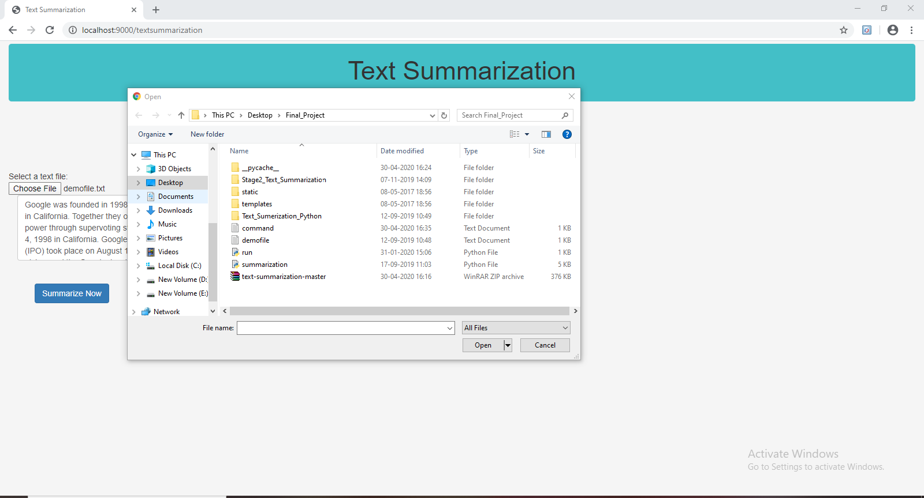
(Continue)
Click on choose file. (select the file we choose for summarize)

Slide 12
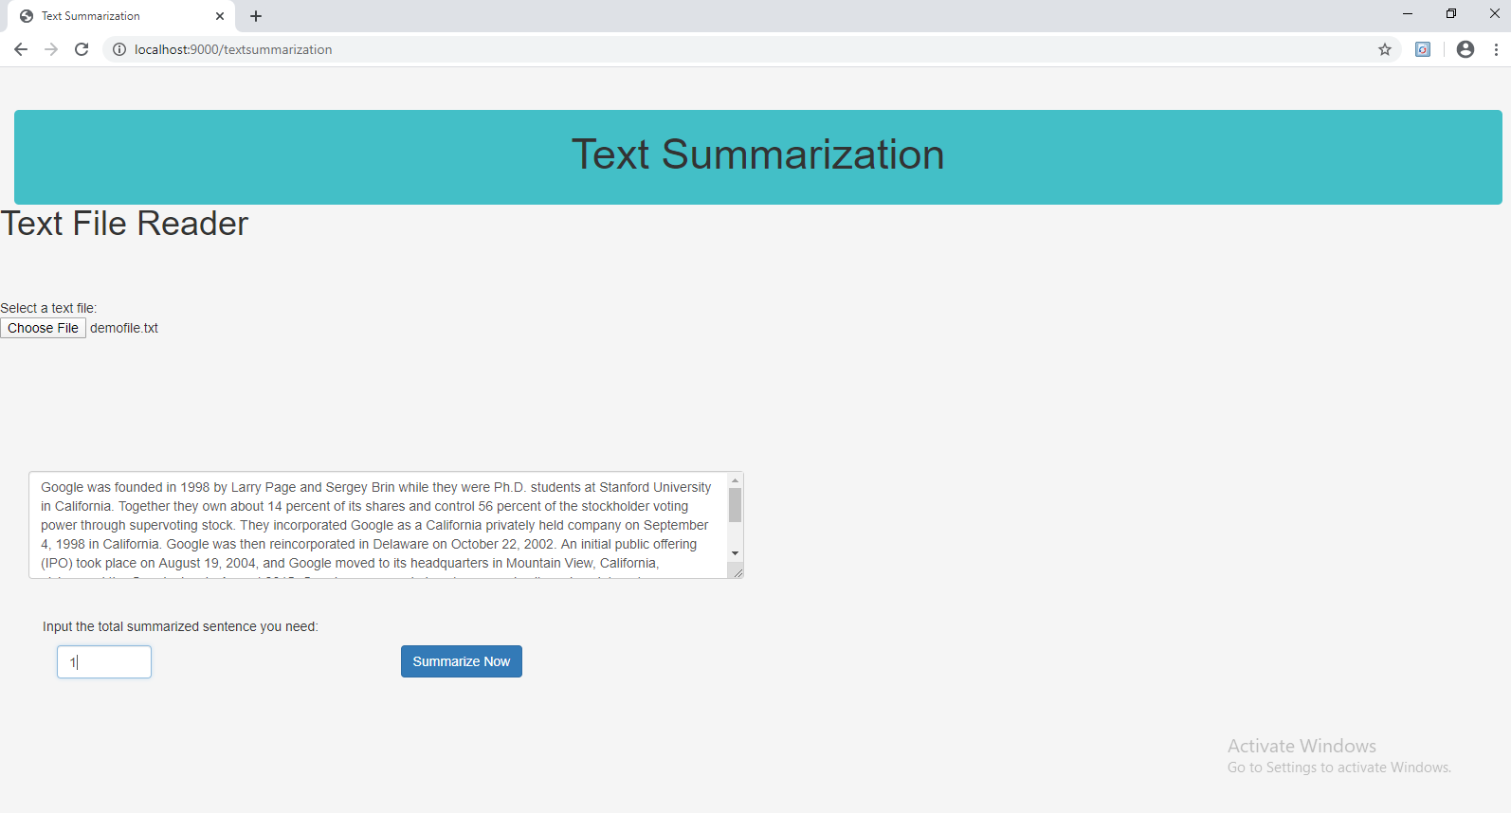
(Continue)
Contents of file displayed

Slide 13
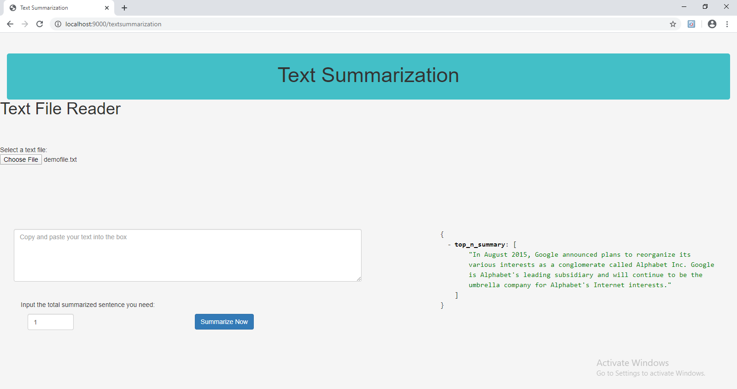
(Continue)
Then the sentence matrix is generated based on the feature score and then based on the score top sentences are selected and arranged as per their occurence in the document.
The final output of the system looks like :

Slide 14
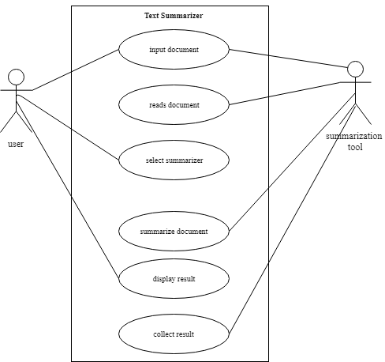
Use Case Diagram
The Use Case Diagram explains the steps of how actor can access the summarization tool.

Slide 15
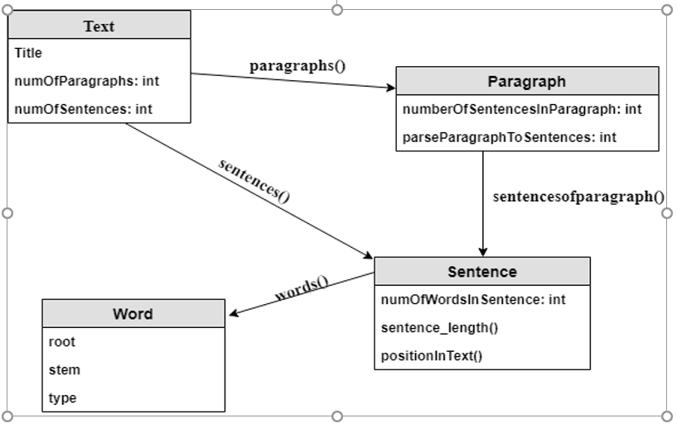
Class Diagram
Text class is the most complex class of the system. It has paragraphs, sentences and words. For dividing text to these parts, text class should have parser methods
Paragraph class is intermediary class of the system. In paragraph object, some necessary calculations are made for sentence features such as number of sentence in paragraph and rank of paragraph in text. It also has own parser to divide the paragraph in sentences.
Sentence Class is the most important class of the system. Sentence object has methods to calculate feature values of itself with the information it takes from text, paragraph and word classes. It has a float list called “features”. “features” list has feature values of the sentence. The system combines “features” lists of the sentence objects of the text, and makes a features matrix with them.
Word class is the most basic class of the system. Using NLP APIs, we can get word’s root, stem, and type of the word such as verb or noun. Also using Word2Vec API, the cosine distance between two words can be calculated. These attributes are used for calculating sentence’s feature values

Slide 16
Conclusion
The objective of the system is to provide a summary of any given text document. Our Algorithm deals with text summarization based on a deep learning method.
The features are processed through different levels of the RBM algorithm and the text summary is generated accordingly.

Slide 17
References
G.Padmapriya,Dr.K.Duraiswamy,”An Approach for text summarization using Deep Learning Algorithm ”,JCSSP,2014.
Ashwini Ambekar, Kajol Shah, Minakshi Agrawal, Simica Pawar, Asma Shaikh, “Text Summarization Using Restricted Boltzmann Machine: Unsupervised Deep Learning Approach”,IEEE, 2018.
Mehdi Jafari, Amir Shahab Shahabi, Jing Wang, Yongruri Qin, Xiaohui Tao, Mehdi Gheisari, “ Automatic Text Summarization using Fuzzy Inference”, IEEE, 2016.
Heena A. Chopade, Dr.Meena Narvekar, “Hybrid Auto Summarization Using Deep Neural Network And Fuzzy Logic System”, IEEE, 2017.
Abdullah Goktug Mert,”Text Summarizer with Deep Learning”,METU,2016.
Trun Kumar,”Automatic text summarization”,NITR,2014.
S.Santhana Megala, Dr. A.Kavitha, Dr. A.Marimuthu,“Enriching Text Summarization using Fuzzy Logic”,IJCSIT,2014.
G.Padmapriya,Dr.K.Duraiswamy,”Association Of Deep Learning Algorithim With Fuzzy Logic For Multi Document Text Summariazation”,JATIT,2014.

Slide 18
THANK YOU

